Slide 1

HISTORY OF THE EMERGENCE OF INDEPENDENT BANGLADESH
Dr. Md. Abdul Alim
B. A (Hon’s), M. A (History), M. Phil (Raj), Ph. D (Raj)
Email:doctorabdulalim64@gmail.com
Cell: +880 01718-787466

Slide 2
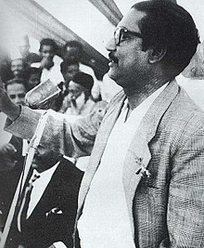
SIX POINTS PROGRAM AND BANGALI NATIONALISM
To get rid of the colonial rule and exploitation of Pakistanis, Bangabandhu Sheikh Mujibur Rahman announced the six points program in 1966. The purpose of Bangabandhu was to free East Pakistan from discrimination by realizing six points of demand. Basically, after the Pak-India war 1965, Bangabandhu raised their voice against the extreme negligence of the West Pakistan Government to the security of East Pakistan and limitless disparities. Opposition leaders convened a conference on 5-6 February 1966 in Lahore where Bangabandhu presented the 'six-points' demand which was rejected by the leaders in the conference.

Slide 3
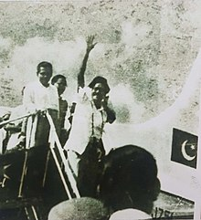
SIX POINTS PROGRAM AND BANGALI NATIONALISM
Bangabandhu walked out of the conference and returned to Dhaka disclosing six points to the press. On 21 February a pamphlet titled 'amader bachar dabi: chhoy dafa karmashuchi' (our demands for survival: six-point program) was published in the name of Bangabandhu. The six points were as follows:

Slide 4
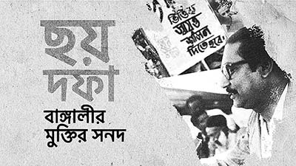
SIX POINTS PROGRAM AND BANGALI NATIONALISM
1. The constitution should provide for a Federation of Pakistan in its true sense on the basis of the Lahore Resolution.
2. The federal government should deal with only two subjects: Defense and Foreign Affairs, and all other residuary subjects shall be vested in the federating states.

Slide 5
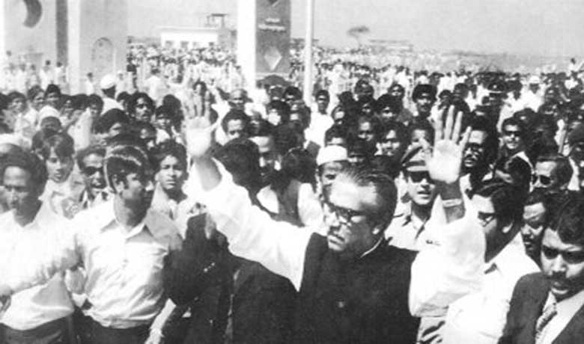
SIX POINTS PROGRAM AND BANGALI NATIONALISM
3. Two separates, but freely convertible currencies for two wings or if this is not feasible, there should be one currency but constitutional provisions to stop the flight of capital from East to West Pakistan. A separate Banking and separate fiscal and monetary policy should be adopted for East Pakistan.
4. The power of taxation and revenue collection shall be vested in the federating units. The federal government shall use this fund to meet its expenditures.

Slide 6
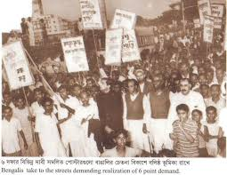
SIX POINTS PROGRAM AND BANGALI NATIONALISM
5. The federal units shall have the full authority to regulate foreign exchange earnings and trade. There should be two separate accounts for the foreign exchange earnings of the two wings.
6. To safeguard regional solidarity and national security the provinces should have the authority to form and control their own military or paramilitary force

Slide 7
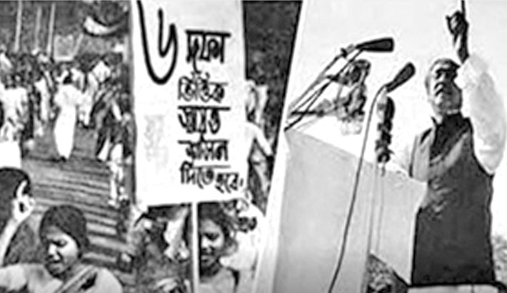
SIX POINTS PROGRAM AND BANGALI NATIONALISM
The six points were accepted by the Working Committee of the Awami League. Then Bangabandhu campaigned in favor of the six points. He went to different places and delivered speeches on this. As a result of Bangabandhu's campaign, six-point gained public support very rapidly. Being panicked the Government of Ayub Khan started arresting the leaders and activists of the Awami League.

Slide 8
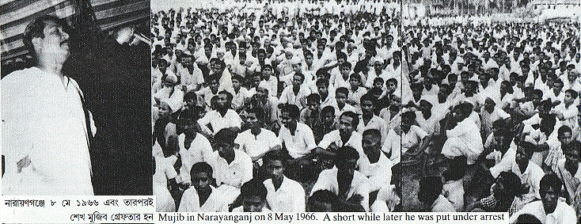
SIX POINTS PROGRAM AND BANGALI NATIONALISM
The Government directed to arrest of Bangabandhu as six points gained popularity day by day. On 7 June a general strike was observed to protest the arrest of Bangabandhu. During hartal, a number of individuals were killed in police firing. By 10 May 1966, the government arrested 3500 Awami League leaders and activists. In 1968 the Government put Bangabandhu on trial accusing him in the historic Agartala Case.
The case led to a mass upsurge in 1969 and the Government was forced to release Bangabandhu Sheikh Mujibur Rahman. The key factor in Awami League's election manifesto in 1970 was these six points programs.

Slide 9
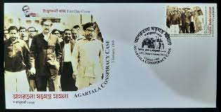
AGARTALA CASE, 1968
It may be mentioned that the six-point program of Bangabandhu in 1966 gained widespread popularity in East Pakistan. Autonomy of East Pakistan became the demand of the people. Meanwhile, a few Bengali officers and soldiers were getting organized for armed revolution to protest the existing disparity in the army. But the matter was uncovered by the Inter-Services Intelligence of the Pakistani government. 1500 Bangali were arrested in Pakistan. Bangabandhu was implicated as the main accused of this conspiracy. Bangabandhu was in jail. A case was filed in January 1968.

Slide 10
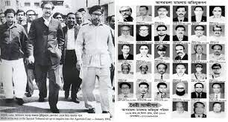
AGARTALA CASE, 1968
The Government framed the charge saying Bangabandhu led a secret meeting with Indian government officials in Agartala, the capital of Indian State Tripura. In the meeting, a plan was designed to liberate East Pakistan through armed movement with assistance from the Government of India. This is why it became known as Agartala Case. But officially the case was termed 'the State vs. Sheikh Mujibur Rahman and gong'. On 9 May 1966 Bangabandhu was released from jail but he was again arrested under martial law at the jail gate and was taken to Dhaka Cantonment. 35 persons were accused in this case

Slide 11
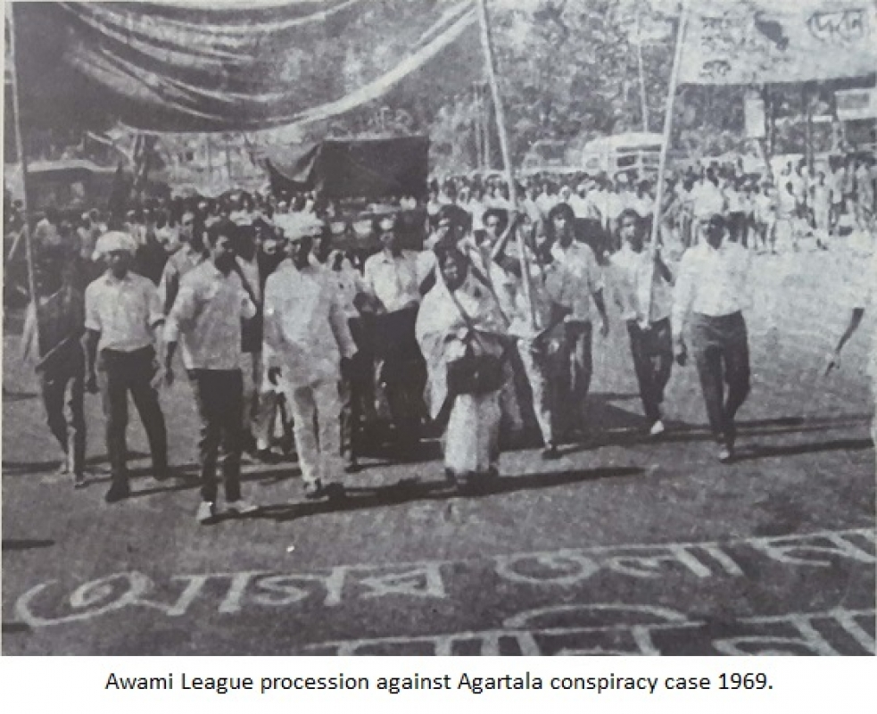
AGARTALA CASE, 1968
Anti-Ayub agitation was getting momentum in both wings of Pakistan during the trial. In East Pakistan people's voices became stronger to realize the demand for the release of Bangabandhu Sheikh Mujibur Rahman and the withdrawal of the case. Gradually the mass movement in East Pakistan turned into mass upsurge in 1969.

Slide 12
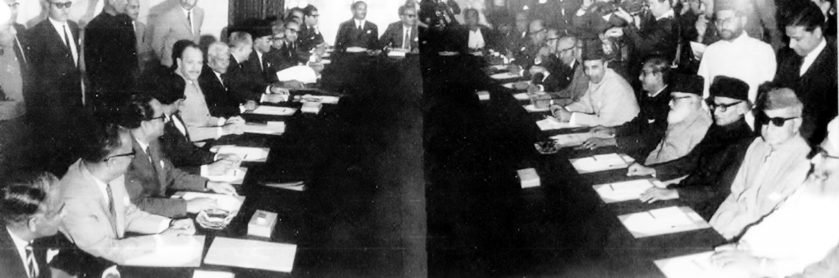
AGARTALA CASE, 1968
In a bid to tame the situation Ayub Khan convened a round-table meeting on 19 February 1969 in Rawalpindi. Maulana Bhashani and Bangabandhu Sheikh Mujibur Rahman were among the others invited to attend the meeting. To pave the way for Bangabandhu to attend the meeting, the Government proposed to release him on parole. But the people of East Pakistan including Maulana Bhashani demanded the withdrawal of the Agartala Case rejecting the Government's proposal.

Slide 13
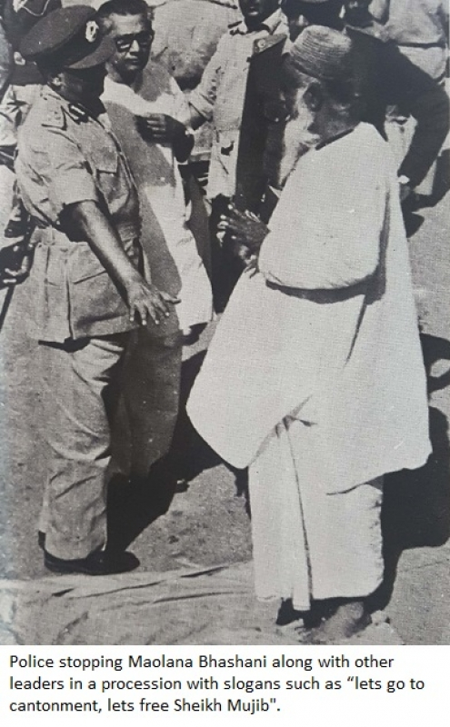
IMPACT OF AGARTALA CASE
At last in the face of the mass movement, the Ayub government was ultimately compelled to withdraw the Agartala Conspiracy Case. All the accused including Sheikh Mujibur Rahman were released on 22 February 1969. On the occasion of the release of Bangabandhu grand public reception rally was organized at the Race Course Ground on 23 February 1969. In that mammoth rally Sheikh Mujibur Rahman was vested with the appellation of 'Bangabandhu'.
This case played a vital role to ignite nationalist consciousness among Bengalis. The purpose that inspired Ayub Government to lodge the case did not gain any success; rather it acted as a boomerang against Ayub Government. At this stage a public leader, Maulana Bhashani, came forward to lead political activities; and Bangabandhu Sheikh Mujibur Rahman was recognized as an unparalleled leader of the Bengalis for his roles as the spokesman of Bengalis interest and autonomy.

Slide 14
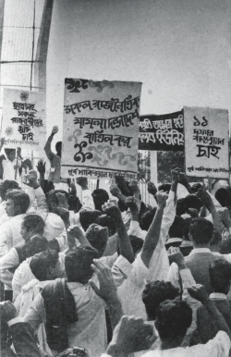
11 POINTS MOVEMENT
During the period of 1968 to 1969 the anti-Ayub mass movement in East Pakistan reached its peak. The momentum of the movement was slowed down as the Awami League leaders got arrested for their role in the mass movement. In this circumstance students took the leadership of the movement. Students' involvement turned the mass movement to mass upsurge.
At the joint initiative of Chhatra League, Chhatra Union (Matia and Menon group) and Dhaka University Central Students Union (DUCSU), student leaders sat together at DUCSU office on 5 January 1969 and formed a united front known as Sarbadaliya Chhatra Sangram Parishad (All Party Student's Action Committee) under the leadership of Tofael Ahmed, the then Vice President of DUCSU

Slide 15
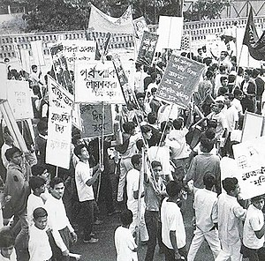
11 POINTS MOVEMENT
Chhatra Sangram Parishad called for mass upsurge based on their 11 points demand. This 11 points program caused inspiration not only among students but also among mass people for the movement. The 11 points demand of the students also included the six points of Bangabandhu. Other important demands included the increase of educational facilities after the withdrawal of notorious DU Ordinance, freedom of speech, individual freedom, freedom of the press, nationalization of large industries, fair wage for laborers, right to form trade union, flood control and proper use of water resources, withdrawal of acts for curfew, emergency and other repressive measures, unbiased foreign policy, immediate release of leaders and activists.

Slide 16
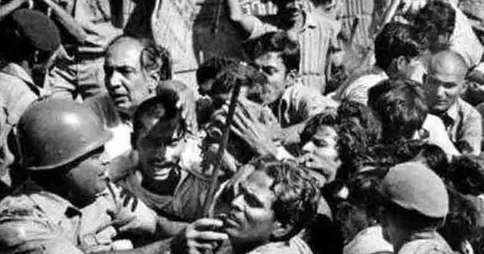
MASS UPSURGE IN 1969
After the meeting was over a huge procession gheraod the Governor's House. Maulana Bhashani declared a hartal the next day, following the violent clash between the police and the demonstrators. On the call of the main opposition parties a hartal was observed throughout East Pakistan on 8 December. Awami League observed. Repression Resistance Day on 10 December. A 'gherao' program was staged on 29 December. The leaders of Chhatra League, Chhatra Union (Matia and Menon group) and Dhaka University Central Students Union sat together on 4 January 1969 and formed a united front known as Sarbadaliya Chhatra Sangram Parishad (All Parties Student Resistance Council).

Slide 17
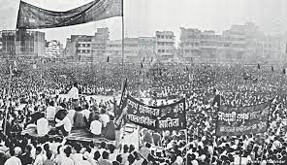
MASS UPSURGE IN 1969
Chhatra Sangram Parishad presented 11 points program which was, by and large, a combination of the six points of Bangabandhu and few other demands. 11 points got support of the Bangalees from all strata of life very soon. During the time of turmoil in 1969, students' 11 point program was a very timely manifestation of the demands of the opposition parties in East Pakistan. This brought the opposition parties together to be united quite rapidly. On 8 January eight parties formed an alliance known as 'Gonotantrik Sangram Parishad' (Democratic Action Committee/DAC) and placed forward 8 points demand.

Slide 18
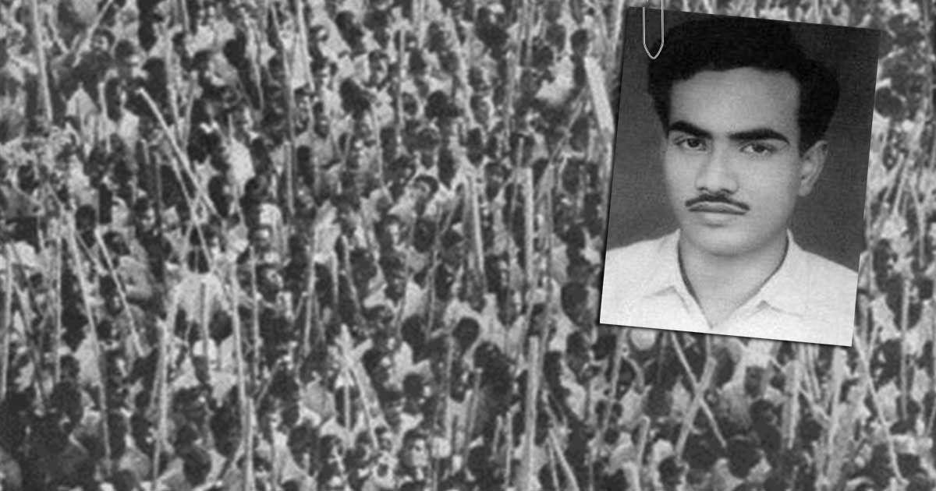
MASS UPSURGE IN 1969
Thereafter at the joint initiative of 'DAC' and Chhatra Sangram Parishad a widespread mass movement developed. A hartal was observed on 14 January in Pakistan at the call of DAC.
Police had a widespread clash with the students during the strike. On 20 January students observed hartal in East Pakistan to protest that brutality. During hartal police fired open in front of Dhaka Medical College, and a student leader Asaduzzaman was killed. In protest of killing Asad, students undertook an extensive program on 22, 23 and 24 January.

Slide 19
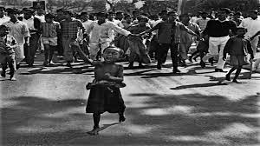
MASS UPSURGE IN 1969
During hartal on 24 January a huge number of people from all walks of life joined the processions. Thus the movement took the shape of a mass upsurge. Again a student of class IX, Matiur, died of police firing, and a large number of people received injuries. An angry mob set fire to the office of Government dailies The Daily Pakistan and Morning News.
Dhaka went out of control of the Government. Indiscriminate firing of the army and the police killed a lot of people and injured many others in the successive movement and hartal after 24 January.

Slide 20
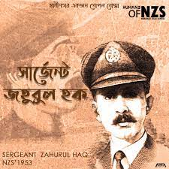
MASS UPSURGE IN 1969
Sergeant Zahurul Haque, an under-trial prisoner in the Agartala Conspiracy Case, was killed brutally by gunshot in Dhaka Cantonment on 15 February. The movement triggered off in protest of the killing of Zahurul Haque on 16 February. Mob set fire to the residence of the Chief Judge of the Agartala Tribunal. In the afternoon, Maulana Bhashani declared in a public meeting, 'Implement 11 points in two months and release all political detainees. If required, we will bring Mujib out of jail by demolishing the prison-like French Revolution.' Finding no other alternative, the Government imposed a curfew in Dhaka.

Slide 21
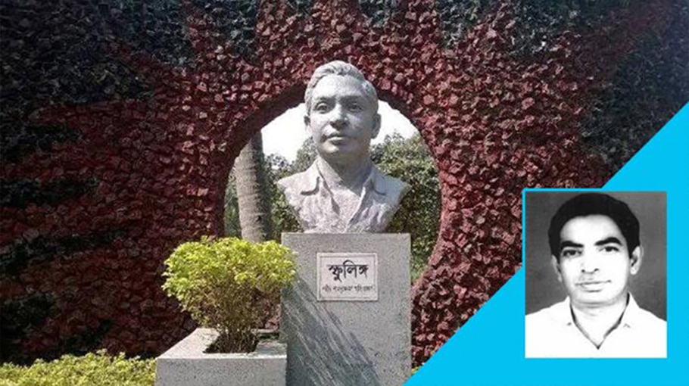
MASS UPSURGE IN 1969
On 18 February, the army bayoneted Dr. Mohammad Shamsuzzoha, the then Proctor of Rajshahi University and killed him.
After 18 February, the movement spread like a wildfire and the overall situation of the country deteriorated. The opposition leaders rejected Ayub Khan's call for a round table meeting. Ayub Khan could realize that the situation would go beyond control unless the Agartala Case was withdrawn and the accused people were released. Yielding to the pressure of the mass upsurge Ayub Khan declared that he would not contest the next presidential election.

Slide 22
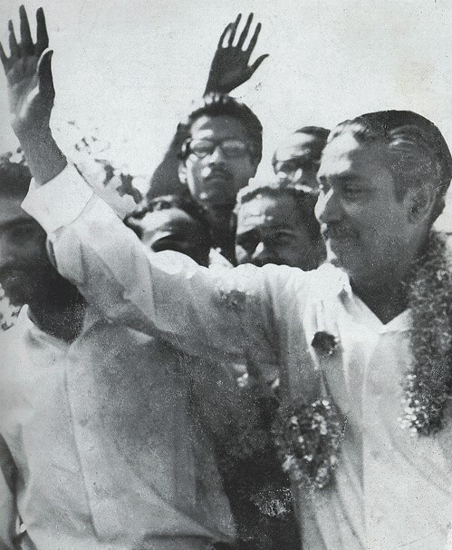
MASS UPSURGE IN 1969
After Bangabandhu Sheikh Mujibur Rahman was freed from the historic Agartala Conspiracy Case, the mass movement of 1969 took a new course. Bangabandhu extended support to the 11-point demand and pledged emphatically that six-point and 11-point would be implemented. He was firm in favor of six-point, and 11-point in the round table meeting with Ayub Khan held on 26 February.

Slide 23
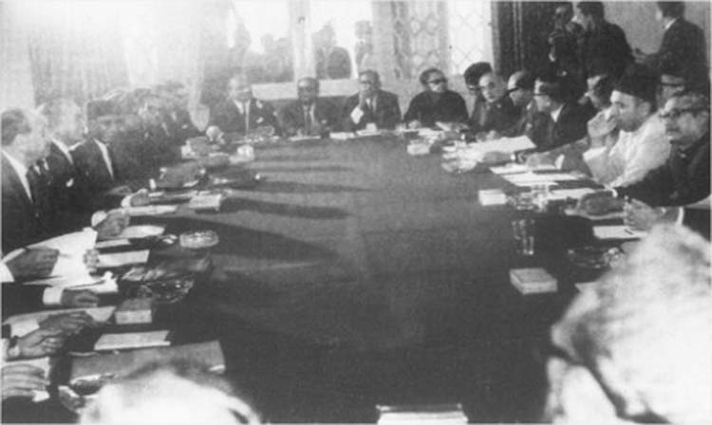
MASS UPSURGE IN 1969
Meanwhile anti-Ayub movement spread in West Pakistan too. Round table meetings failed. Law and order situation worsened in the whole country. In March, 90 people died as the army fired on demonstrations. Finally, in a meeting held on 10 March, Ayub Khan declared that he would introduce a Parliamentary Form of Government and the elections would be held, ensuring voting rights of the adults.

Slide 24
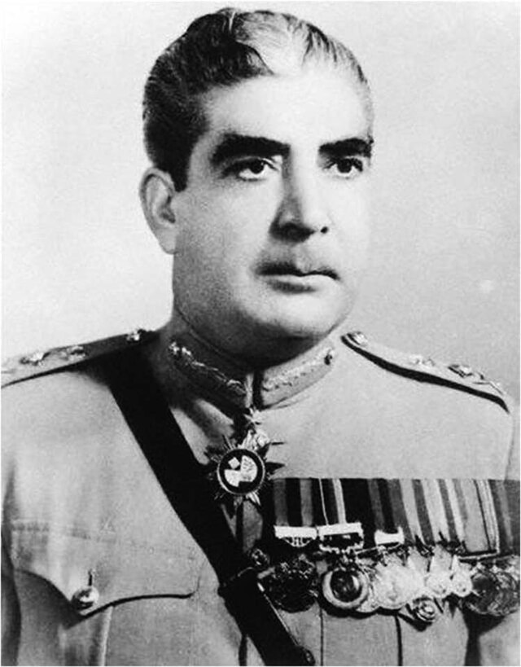
MASS UPSURGE IN 1969
On 22 March, Ayub Khan removed Monaem Khan from the post of Governor of East Pakistan. Still, the mass movement could not be tamed. On 25 March, Ayub Khan handed over the rein of the Government to the Army Chief General Yahya Khan. Thus anti-Ayub mass upsurge in East Pakistan gained success.

Slide 25


